Slide 1
Eloqua Connector

Slide 2
Eloqua Connector – Outbound Process
RPI Offer
Send Type?
Map contact fields (based on channel configuration)
Create Custom Object (based on channel name)
Create Shared Contact List
Create Contact Import Definition
Campaign
Test Offer
Existing
Contact?
Send using transactional email endpoints
(no campaign)
New contacts are subscribed globally to all lists with “No Status”
No
Upload Contacts and update mapped fields
Create Custom Object Import Definition
Yes
Email Providers
Upload Custom Object data (includes RPI generated IDs)*
Create Email Asset
Create Dynamic Content Assets (if applicable)
Eloqua Delivers Messages
Update RPI Offer Log with Send Confirmation
Activate Campaign
Create Campaign Asset
Create Contact Segment Asset
* For Queue Listener sends, the RPCONTACTID is not included in the upload to the custom object. Standard batch sends will include the RPCONTACTID.

Slide 3
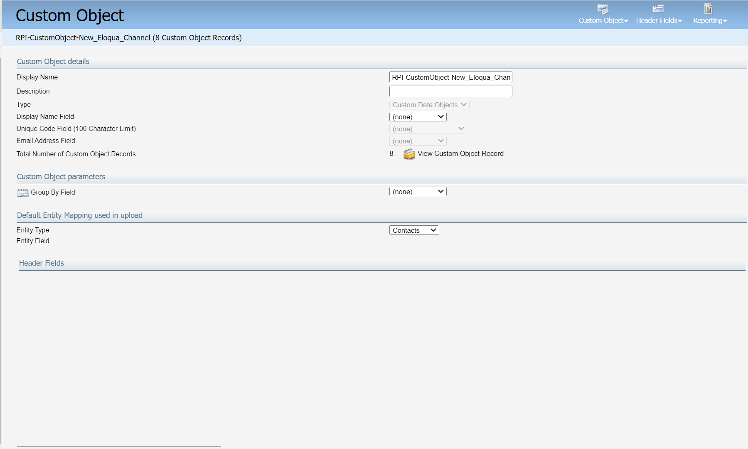
Eloqua Connector – Outbound Process (Cont.)
Create Custom Object (based on channel name)

Slide 4
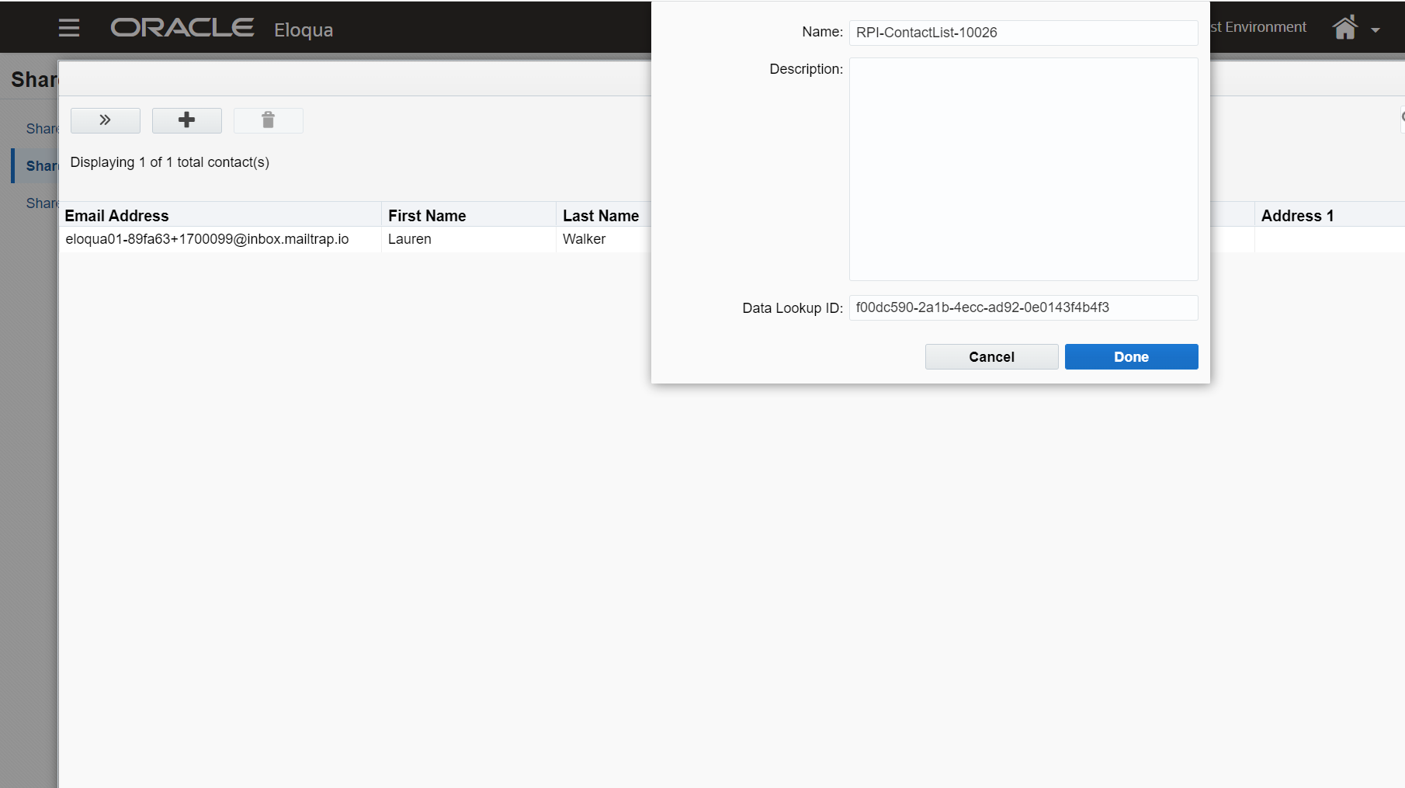
Eloqua Connector – Outbound Process (Cont.)
Create Shared Contact List

Slide 5
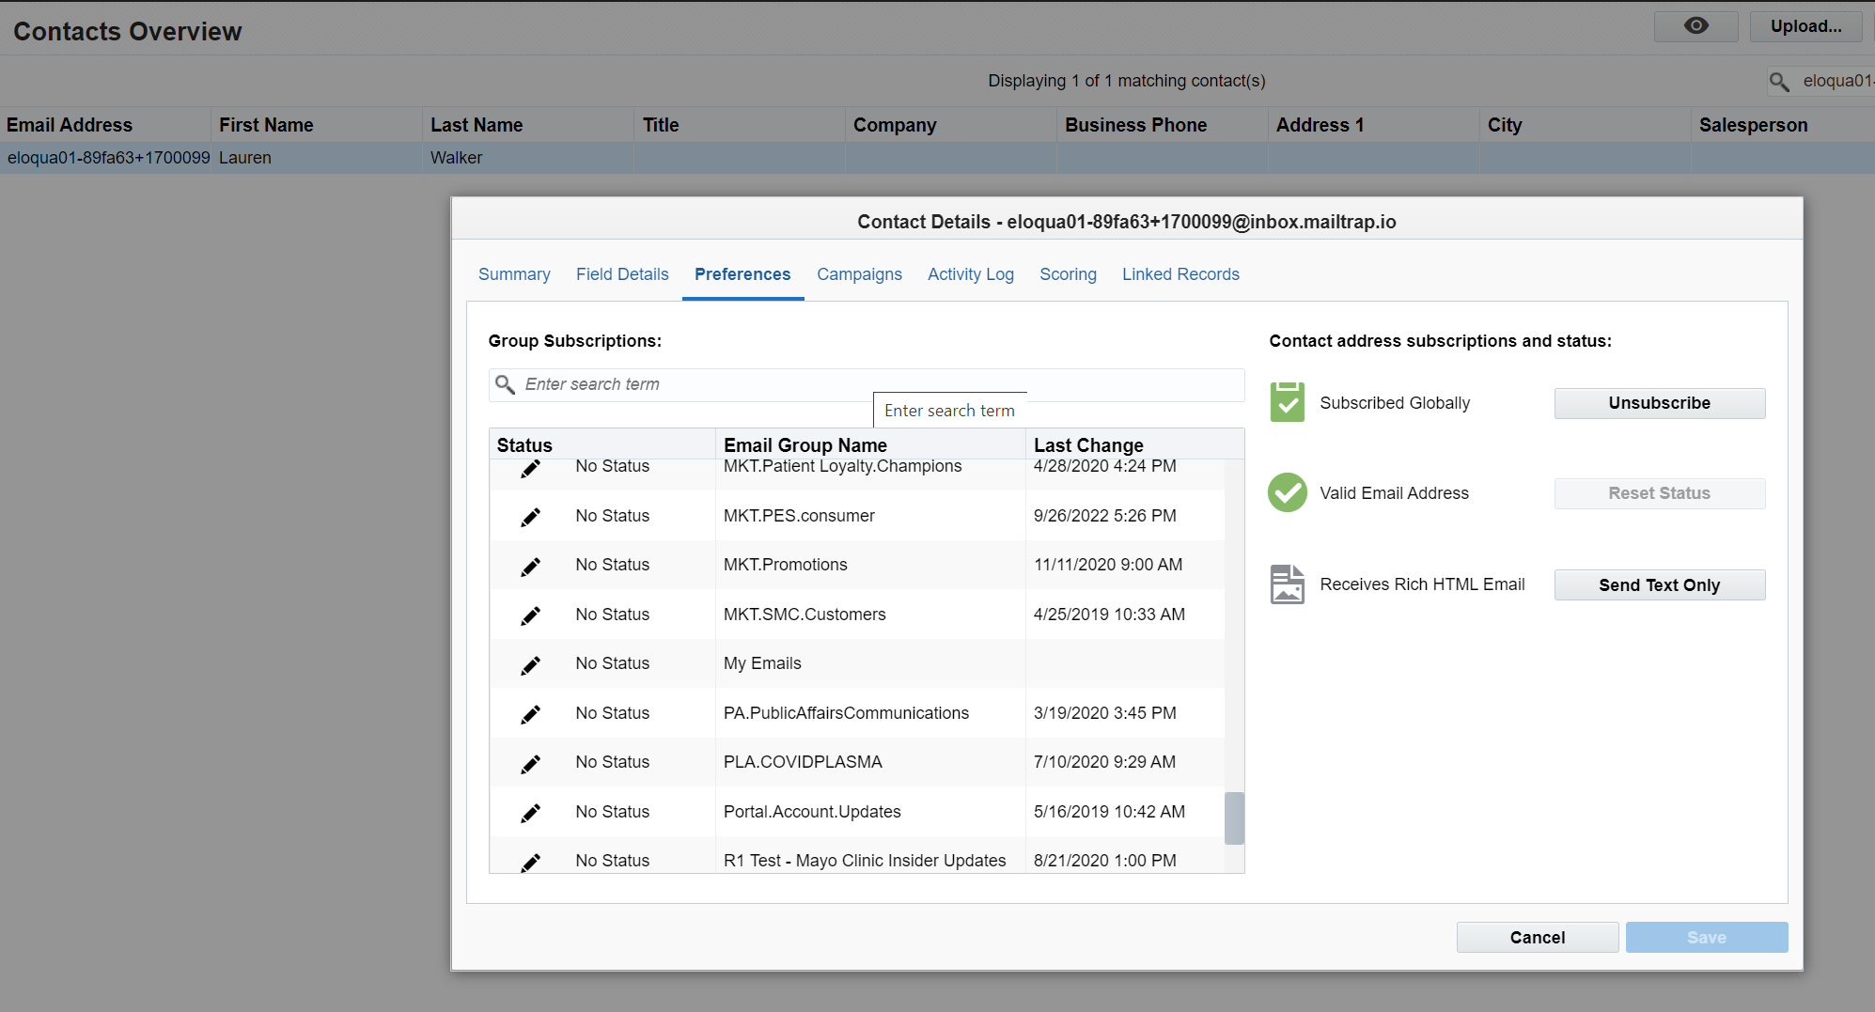
Eloqua Connector – Outbound Process (Cont.)
New contacts are subscribed globally to all lists with “No Status”

Slide 6
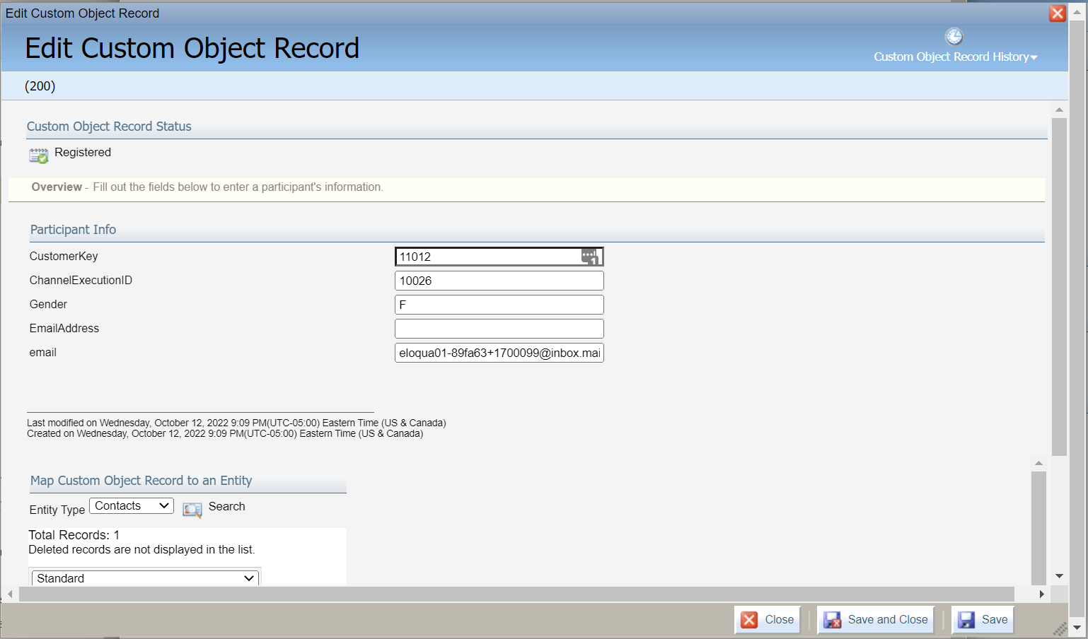
Eloqua Connector – Outbound Process (Cont.)
Upload Custom Object data (includes RPI generated IDs)

Slide 7
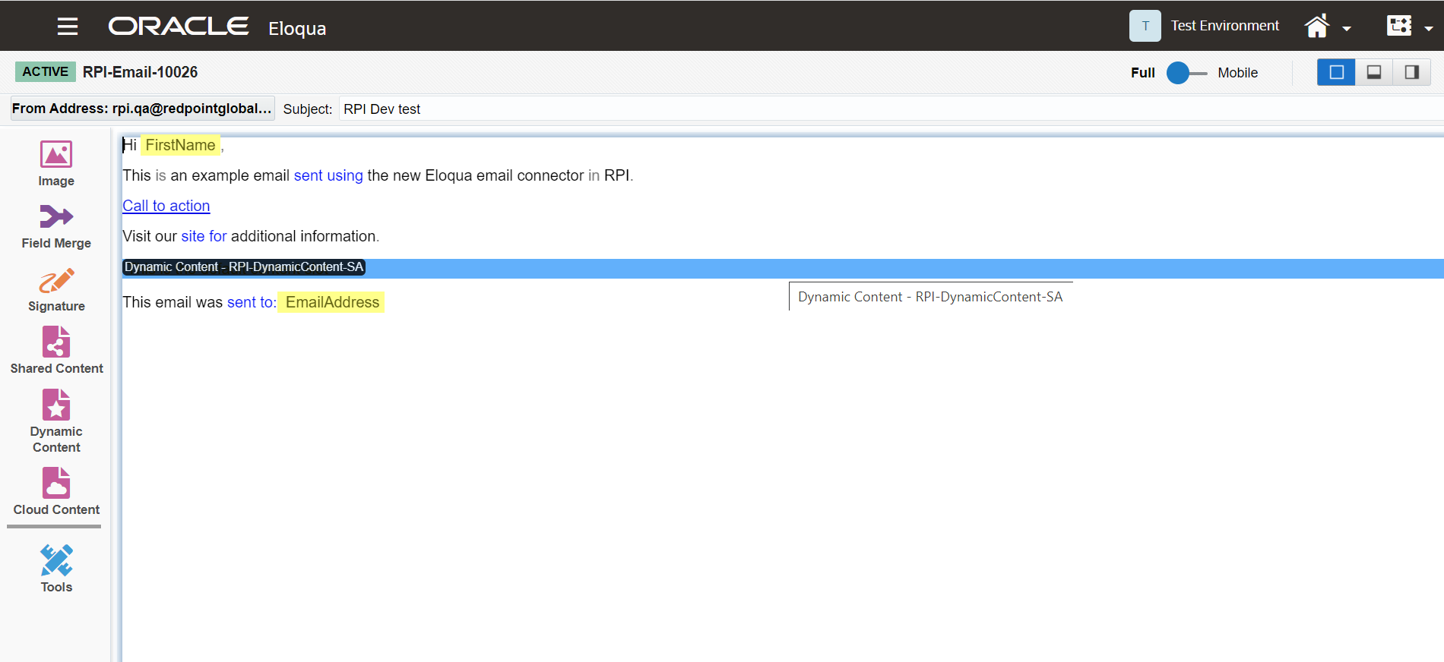
Eloqua Connector – Outbound Process (Cont.)
Create Email Asset

Slide 8
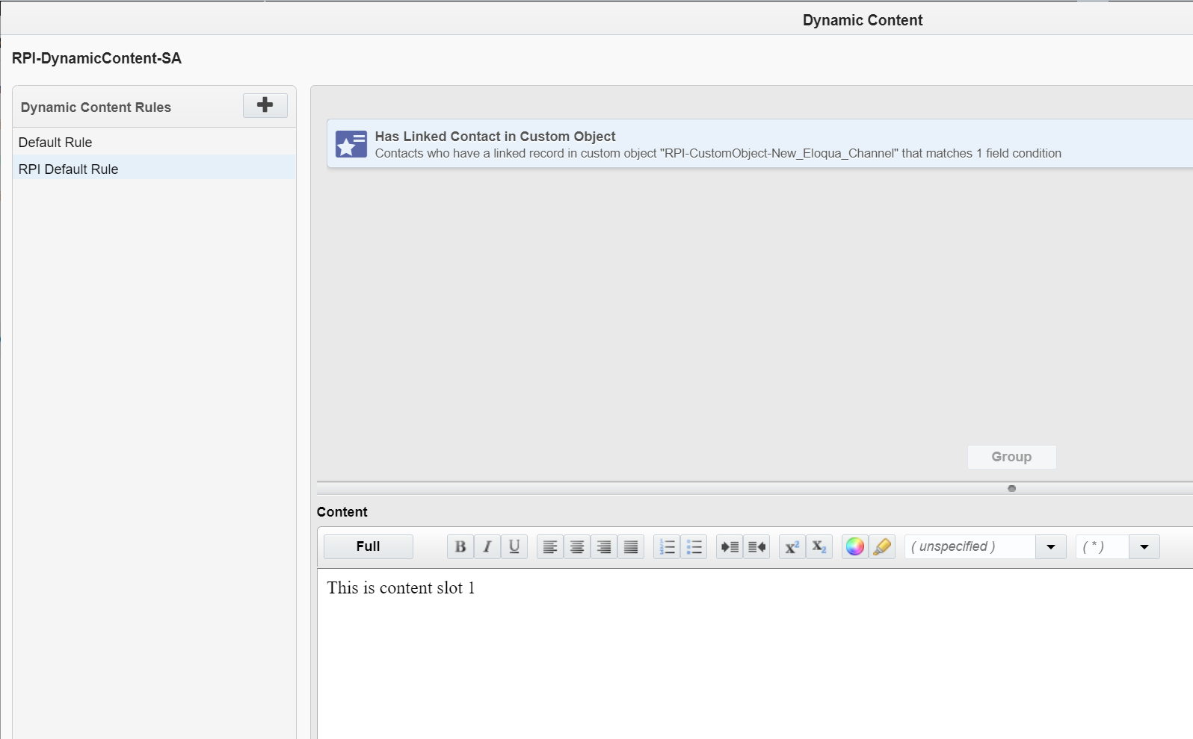
Eloqua Connector – Outbound Process (Cont.)
Create Dynamic Content Assets (if applicable)

Slide 9
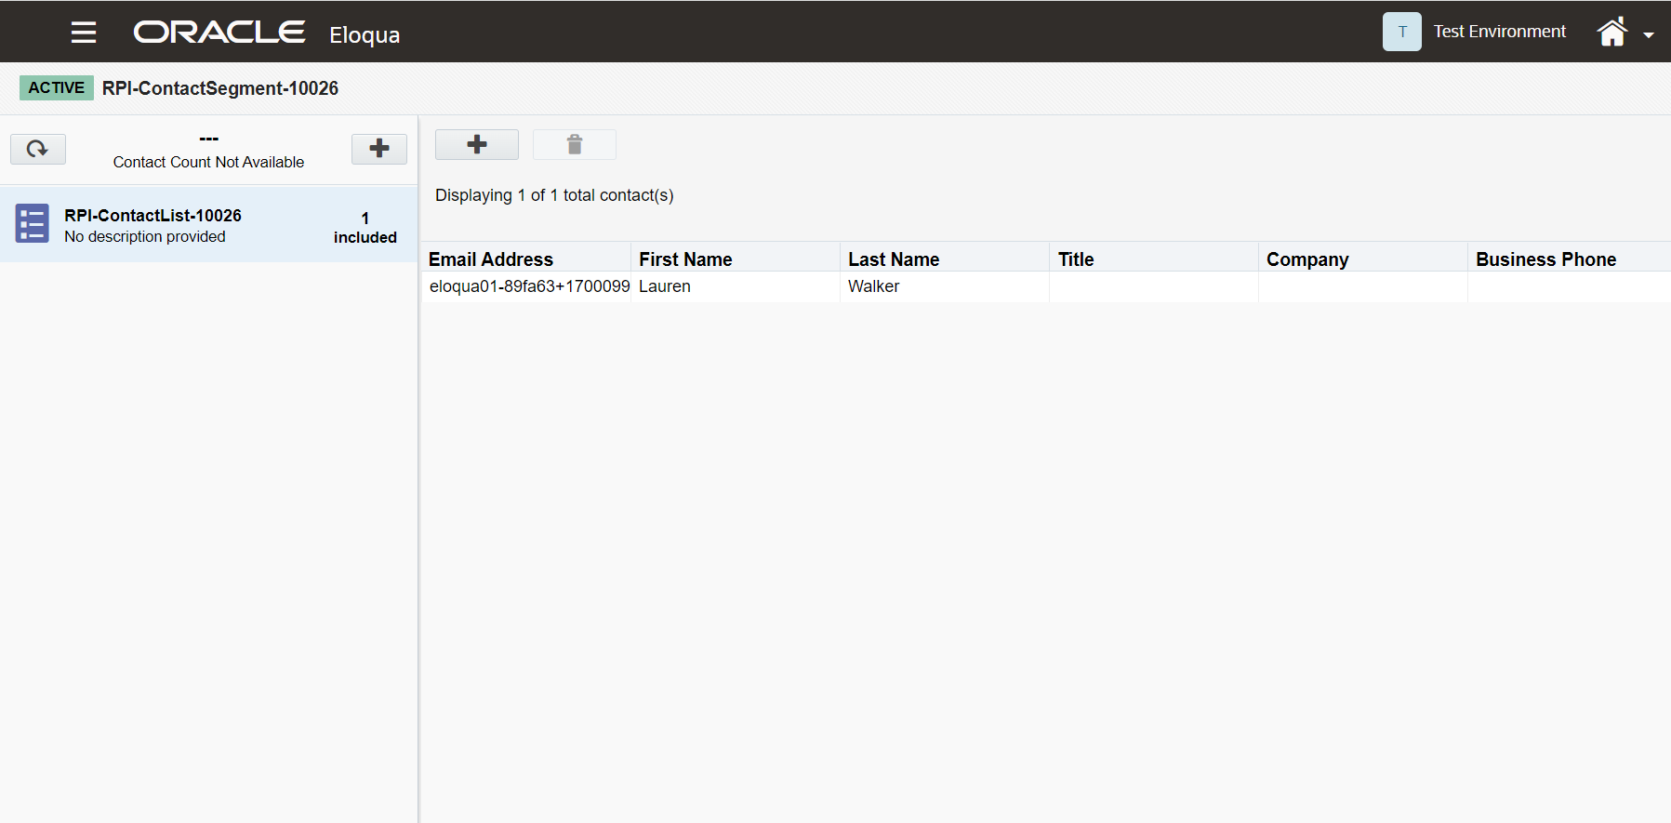
Eloqua Connector – Outbound Process (Cont.)
Create Contact Segment Asset

Slide 10
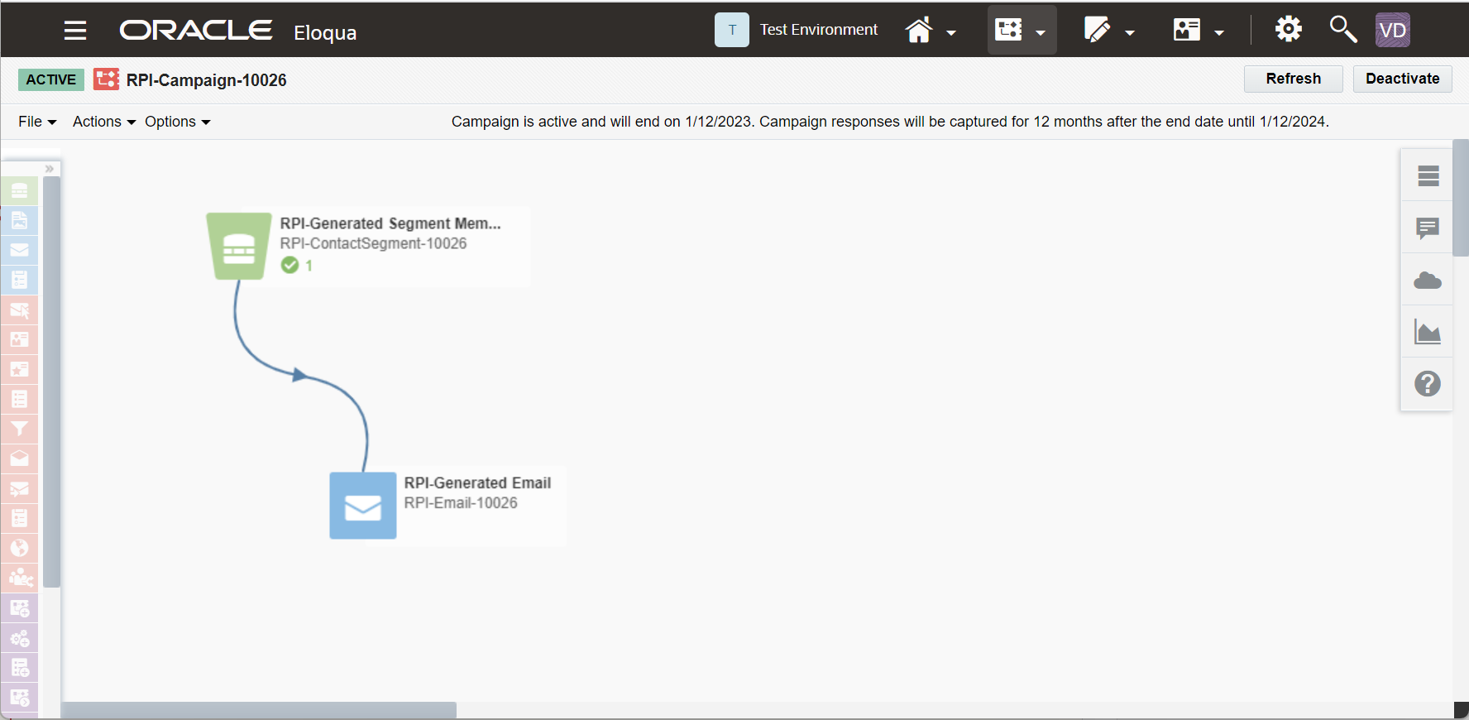
Eloqua Connector – Outbound Process (Cont.)
Create Campaign Asset

Slide 11
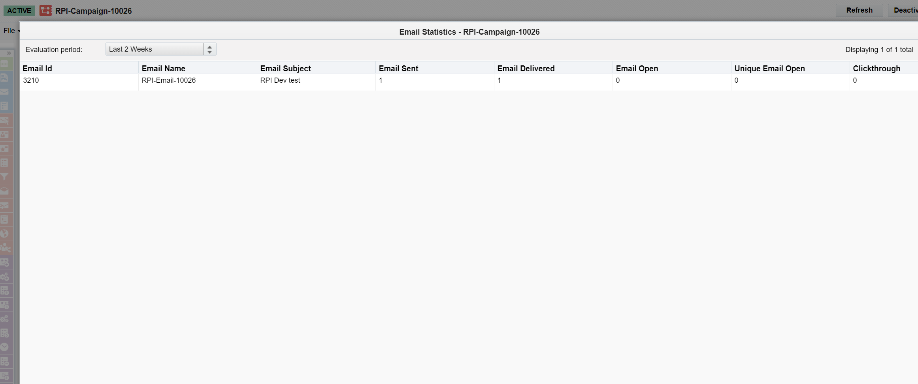
Eloqua Connector – Outbound Process (Cont.)
Eloqua Delivers Messages

Slide 12
Eloqua Connector – Inbound Process
Connectivity Test
Eloqua Channel Sync Task
Passed
Create Export Definition for Event Data
Export Event data from Eloqua
Load data to a staging table on the database
Failed
Retry up to 10 times
Wait until next channel sync (10 minutes default)
Update campaign result counts
Insert Deduped data to Offer History States

